Slide 1
USER INTERFACES for EMBEDDED SYSTEMS
Lecture 11: Issues-Based Metrics
Stefan Wagner
sw@eng.au.dk

Slide 2
Issues-based metrics
Usability issue
“A problem that must be settled”
Has negative connotations
Often rated / quantified by severity
We want to get rid of issues
Usability finding
“Something that is found via investigation”
Has positive connotations
Often rated / quantified by impact
We want to keep findings

Slide 3
Example usability issues
Anything that prevents task completion
Anything that takes user off-course
Anything that creates confusion
Anything that produces an error
Not seeing something that should be noticed
Assuming something is correct when it is not
Assuming a task is complete when it is not
Performing wrong actions
Misinterpreting information or content
Not understanding the navigation
Identify and take action to improve design

Slide 4
Example usability findings
Supporting the user in completing a complex transaction without any confusion and in the most efficient way possible
Anticipating a user's needs at every step of a process
Educating a user without any effort involved
Displaying complex information in a clear, simple format that users can easily understand
Here - Think Aloud is a well-suited method!

Slide 5
Severity rating
Granularity
3: Low, medium, high
5: Cosmetic, low, medium, high, catastrophe
Examples
Cosmetic: Minimal, e.g. visual changes in UI
Low: Irritates user, but does not yield task failure. May reduce efficiency and/or satisfaction.
Medium: Adds time on task and impacts effectiveness, efficiency and satisfaction
High: Leads to task failure. Significant impact on effectiveness, efficiency, and satisfaction.
Catastrophe: Loss of data or damage to SW/HW

Slide 6
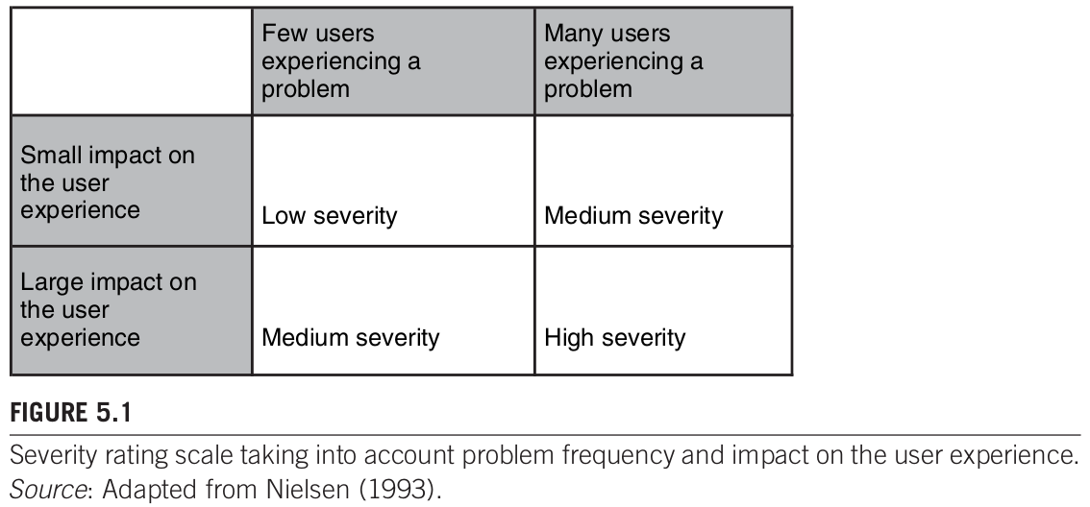
Severity rating
Combination of: Impact on user experience and problem frequency
[T&A]

Slide 7
Bias in identifying usability issues
Bias types
Participants: Range in knowledge, motivation etc.
Tasks: Determines exercised area of product
Methods: Lab test, expert review etc.
Artifacts: Paper or (semi) functional prototype, or...
Environment: Lab, simulated or real environment …
Moderators: Usability professional's experience ...

Slide 8
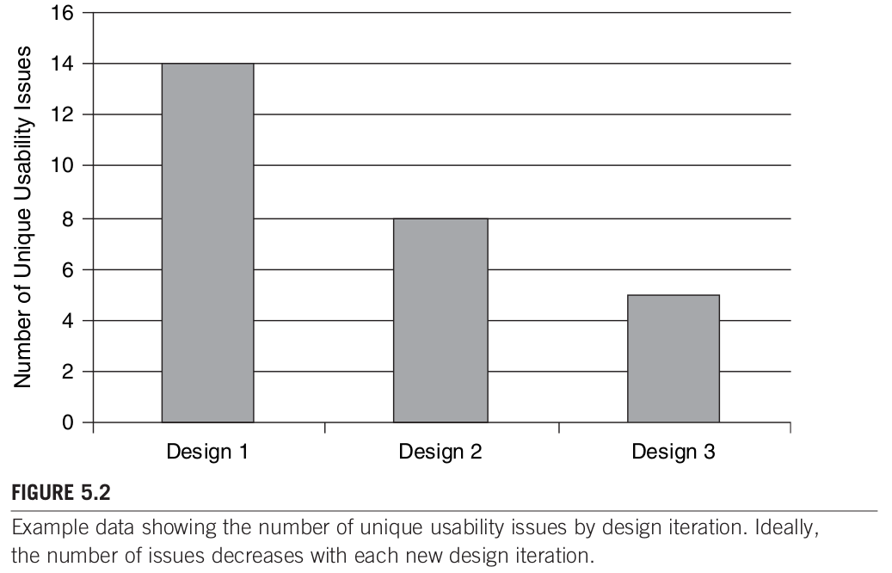
Issue-based metrics in action (1/4)
[T&A]

Slide 9
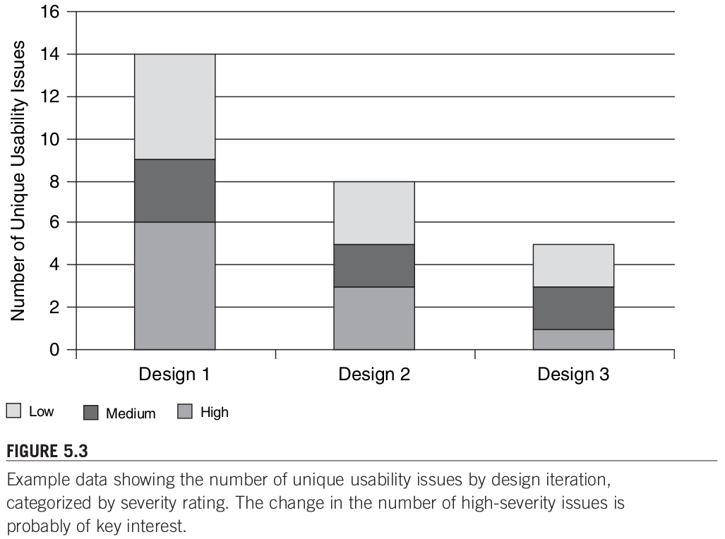
Issue-based metrics in action (2/4)
[T&A]

Slide 10
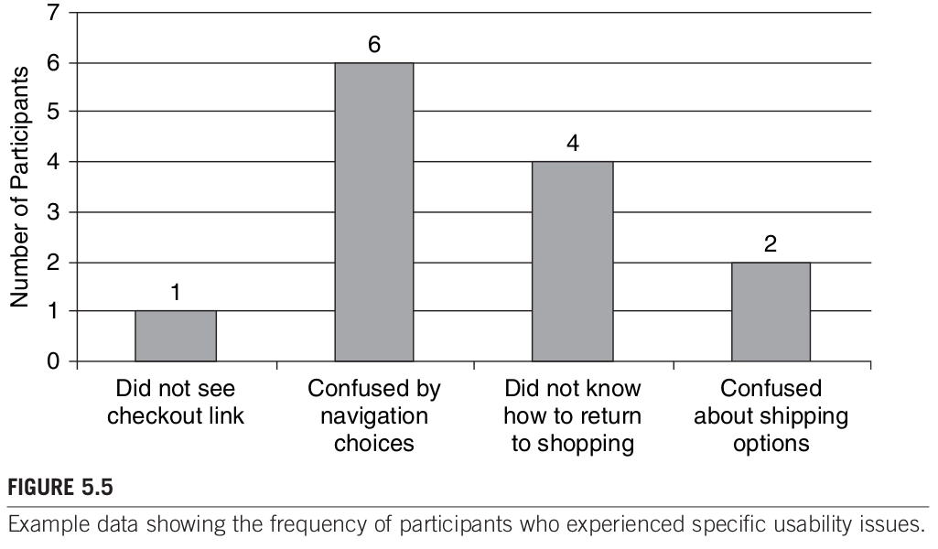
Issue-based metrics in action (3/4)
[T&A]

Slide 11
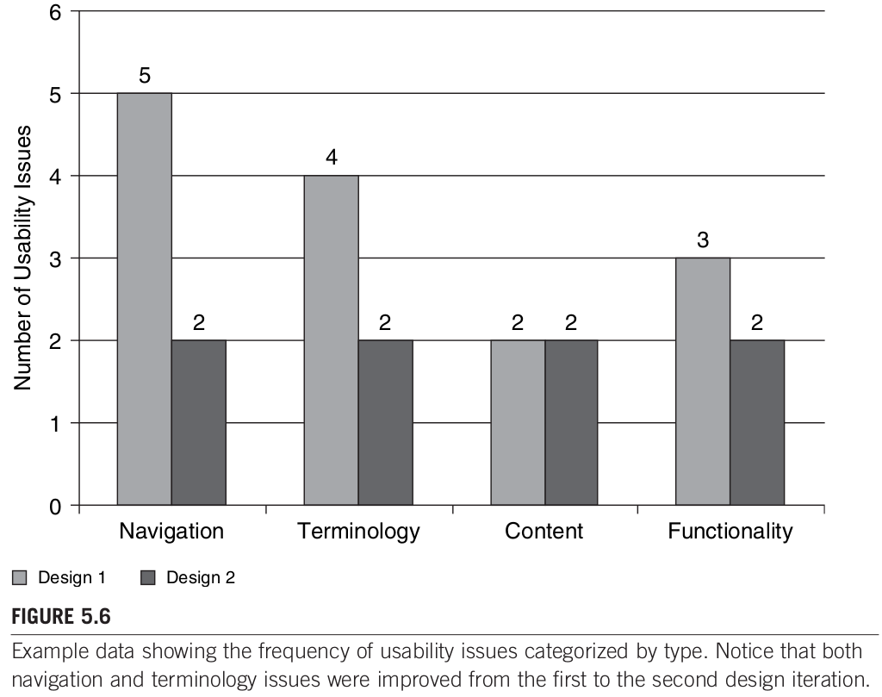
Issue-based metrics in action (4/4)
[T&A]

Slide 12
How many users are needed?
Two different viewpoints on “the magic number 5”
5 participants are enough
Studies back this...
5 participants are not enough
Studies back this...
What to believe?
Choose at least 5 participants per “significantly different user class”
Keep the scope of evaluation task limited to few functions
Keep user population “well” represented

Slide 13
References
[T&A] Tullis and Albert, Measuring the User Experience, 2008
[S,R&P] Sharp, Rogers, and Preece, Interaction Design, 2002
[JN] Jakob Nielsen, Usability Engineering, 1994
[JR] Jeffrey Rubin, Handbook of Usability Testing, 1994
[JJG] Jesse James Garret, The Elements of User Experience, 2002

